Slide 1

MARCHE DRONE WEEK 2018 patrocinio del Consiglio regionale
Prof. Ing. Loris Penserini
CTIO, TTP Technology
elpense@gmail.com
Iniziativa realizzata in collaborazione con:
Prof. E. Tonucci – TTP Technology, ITALY
Prof. G. Ippoliti – DII dell’Università Politecnica delle Marche
Dott. David Francescangeli – Centro Universitario Sportivo di Ancona

Slide 2
Innovare nel Territorio partendo dalle Scuole e dalle Università attraverso lo SPORT e le TECNOLOGIE
Perché?
Notes:
APPROCCIO BOTTOM-UP
Tanti anni passati a lavorare per la Commissione Europea…

Slide 3
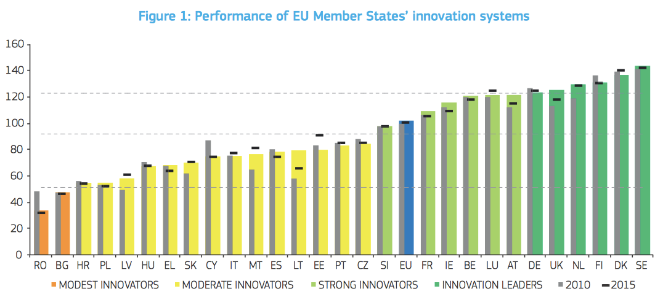
L’Italia Innova poco
Notes:
Society is changing

Slide 4
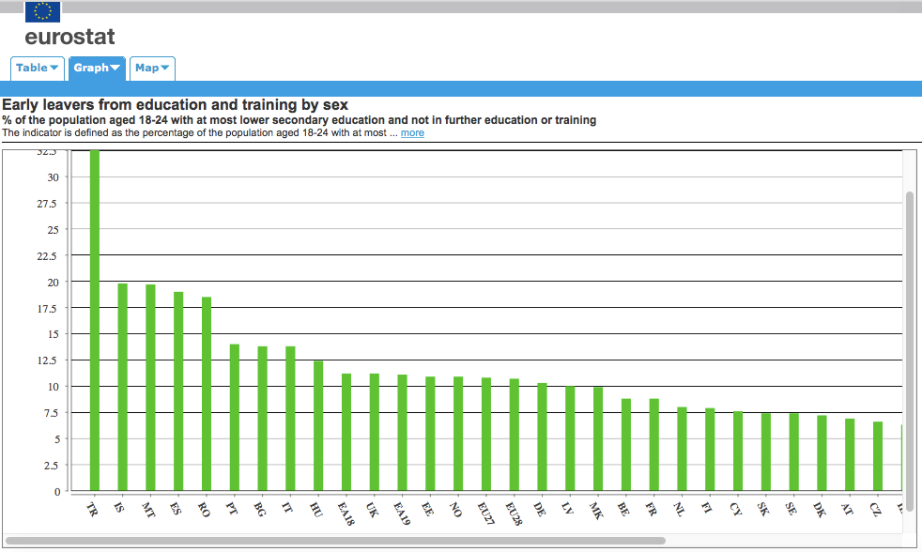
Forte Abbandono Scolastico
Notes:
Society is changing

Slide 5
STRUMENTI
Intercettare le risorse finanziarie provenienti da bandi FSE PON e ERASMUS+ come prevede anche il PNSD per le Scuole:
Pandora
Make in Class
FABLAB: mettere a disposizione capitale umano e macchinari per fare sperimentazione anche in orario curricolare
DRONE@SCHOOL progetto rivolto alle scuole: https://ttp-technology.it/scuola/drone-kit.html
Associazione Sportiva Dilettantistica: DRF – DRONE RACING FANO iscritta nel registro del CONI
Iniziative per fare networking e creare sinergie sul territorio:
MARCHE DRONE WEEK 2018
FANO DRONE ACCADEMY: C.A. per PILOTI DI DRONI
Notes:
Creare le giuste sinergie per favorire l’Innovazione Digitale come auspicato dal PNSD del MIUR e da Europa2020.

Slide 6
Agenda
FRAMEWORK PER LO SVILUPPO DI SISTEMI AUTONOMI
Ingegneria del Software e Programmazione Avanzate
Rappresentazione della conoscenza con Tropos4AS
Ambiente di Sviluppo per DRONI Intelligenti

Slide 7
Motivation
Today’s software is complex because it is expected to work autonomously in a dynamic, open, unpredictable environment.
Self-adaptive systems (SAS) give a promising solution to cope with these issues.
Self-adaptive systems (following [Laddaga, 2006])
automatically take the correct actions based on their knowledge of what is happening in the environment,
are guided by the objectives, the stakeholders assigned to them.
are able to prevent failure, exploiting design variability, and managing recovery from errors.
Notes:
Autonomous systems include Self-Adaptive systems. The latters are the most complex ones.

Slide 8
SOPHIA, IL PRIMO ROBOT CON CITTADINANZA
In Arabia Saudita un robot umanoide ottiene la cittadinanza…
https://video.panorama.it/news-video/sophia-primo-robot-con-cittadinanza/
Notes:
This technology is going to be relevant in several sectors because of services they can generate, improving traditional ways of doing things.

Slide 9
Project Aim
Based on foundational research
The main aim is to build a development framework for DRONE systems adapting know-how and tools from Agent Oriented Software Engineering techniques for Self-Adaptive and Autonomous Systems.
This work mainly refers to the following research papers:
Loris Penserini, Emanuele Tonucci, Gianluca Ippoliti, Jessica Di Labbio, "Development Framework for DRONEs as Smart Autonomous Systems", in Proc. of The 8th International Conference on Information, Intelligence, Systems and Applications (IISA). Proceedings will be published by IEEE. Larnaca, Cyprus, August 28-30, 2017.
Mirko Morandini, Loris Penserini, Anna Perini, Alessandro Marchetto, “Engineering Requirements for Adaptive Systems”, Requirements Engineering Journal – REJ, ISSN 0947- 3602, Vol.20-Num.3, SPRINGER, 2015. (DOI 10.1007/s00766-015-0236-0)
Loris Penserini, Anna Perini, Angelo Susi, John Mylopoulos, "High Variability Design for Software Agents: Extending Tropos", ACM Transactions on Autonomous and Adaptive Systems (TAAS) Journal, 2007.
Loris Penserini, Anna Perini, Angelo Susi, Mirko Morandini, John Mylopoulos, "A Design Framework for generating BDI-Agents from Goal Models", in Proc. of The 6th International Joint Conference on Autonomous Agents and Multiagent Systems (AAMAS07), Honolulu, Haway, May 14-18, 2007.
Notes:
Autonomous systems include Self-Adaptive systems. The latters are the most complex ones.

Slide 10
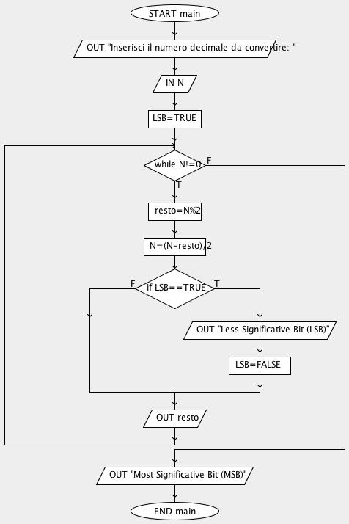
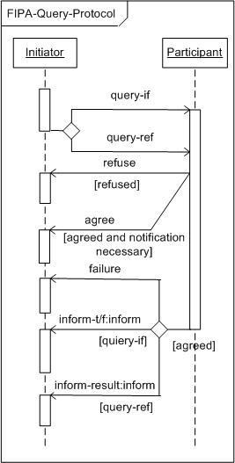
Background
Abstraction Levels in Software Engineering:
Flow-Chart
(Structured Prog.)
UML
(Object Oriented Prog.)
Agent-UML
(Agent Oriented Prog.)
Notes:
In questa slide si sintetizzano circa 30 anni di storia dell’ingegneria del software

Slide 11
SE Programming tools
Software Development tools that abstract from the complexity of the programming language paradigms by using Software Engineering modelling languages:
Flow-Chart → AlgoBuild – an educational software built to study programming and algorithms
UML → BlueJ – Interactive Java Environment
AOSE → Taom4AS – Combines Goal Oriented and Agent Oriented methodologies
Notes:
Il nostro obiettivo è creare degli strumenti, per sviluppare droni intelligenti, che possano essere usati anche da non esperti

Slide 12
Software Agents
Agent-technology has been applied in many scenarios, the most popular agents can be grouped as follows:

Slide 13
Architecture of a
“Smart” Agent
Agent Oriented Software Engineering (MaSE, GAIA, Tropos4AS,...)
[DeLoach et al., 2001][Henderson-Sellers and Giorgini, 2005] [Penserini et al., 2007a] …
Agent Oriented Programming (JACK, 3APL, JADEX, …)
[Busetta et al., 2000][Dastani et al., 2005][Pokahr et al., 2005]
BDI Agent Architecture:
AGENT
Knowledge
Base
Sensor
Agent
Kernel
Goals
Commu-nication
Capabilities
UI

Slide 14
Agenda
FRAMEWORK PER LO SVILUPPO DI SISTEMI AUTONOMI
Ingegneria del Software e Programmazione Avanzate
Rappresentazione della conoscenza con Tropos4AS
Ambiente di Sviluppo per DRONI Intelligenti
Notes:
This technology is going to be relevant in several sectors because of services they can generate, improving traditional ways of doing things.

Slide 15
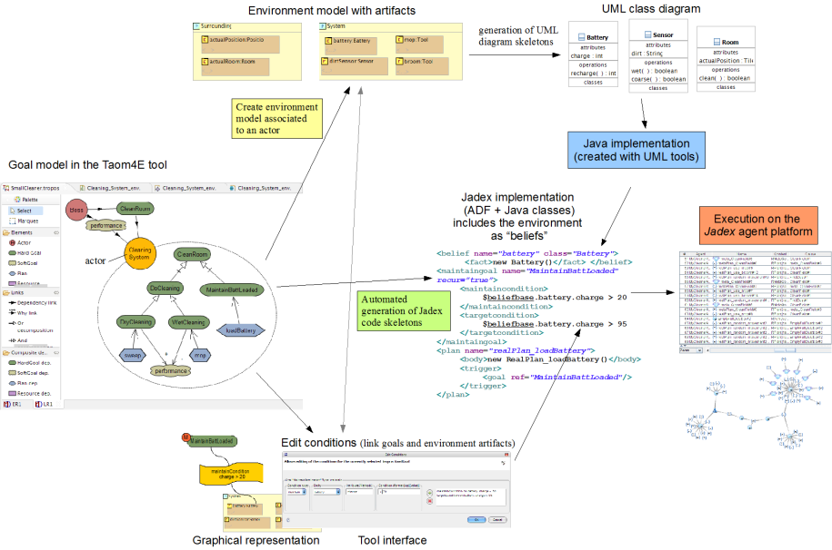
Agent Oriented Software Engineering (AOSE)
Several AOSE methodologies have been developed: Tropos4AS, MaSE, Prometheus, Agent – UML, …
Tropos4AS
Jadex

Slide 16
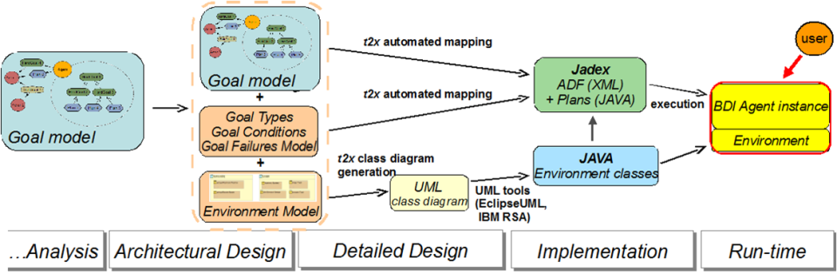
Tropos4AS: tool-supported process
The new modelling steps are collocated after the Tropos architectural design phase.
Mapping to BDI agents
Prototype implementation

Slide 17
Knowledge level modelling
The Cleaner Agent (robot):

Slide 18
Tropos4AS:
Code Generation in Jadex
The mapping in the ADF of Jadex:
Run-Time
Design-Time

Slide 19
Agenda
FRAMEWORK PER LO SVILUPPO DI SISTEMI AUTONOMI
Ingegneria del Software e Programmazione Avanzate
Rappresentazione della conoscenza con Tropos4AS
Ambiente di Sviluppo per DRONI Intelligenti
Notes:
This technology is going to be relevant in several sectors because of services they can generate, improving traditional ways of doing things.

Slide 20
DRONE as an
Autonomous System
So far, several terms have been used such as Unmanned Aircraft Systems (UAS), Remotely Piloted Aircraft Systems (RPAS) (a UAS subcategory). Now in [NPA, 2015-10] the European Aviation Safety Agency (EASA) definition is:
“Drone shall mean an aircraft without a human pilot on board, whose flight is controlled either autonomously or under the remote control of a pilot on the ground or in another vehicle.”
“DRONEs can be conceived as autonomous systems”

Slide 21
Reference Model
Development framework
The development framework for DRONE systems deals with an integration process of several technologies.
Design-Time
Knowledge Level Modelling
Simulator
APM
Planner
BDI Agent Architecture
Abstraction-Levels
Run-Time
Rover
Rover
Drone
Drone
Robot-Time
(Flight-Time)
ArduPilot – Flight Control
Notes:
The CHALLENGE is the integration process of several technologies

Slide 22
Approach advantages
Robots, as well as Self-Adaptive Systems, need to be able to take decisions on a requirements level at “robot-time”!
AOSE methodologies model systems as actors with their goals and dependencies.
Goal-directed “BDI” agent-oriented programming languages provide appropriate implementation abstractions:
agents, goals, plans
reasoning cycle

Slide 23
Approach advantages and …
Reduce the gap between requirements, design & implementation levels, and ensure traceability
Awareness of the high-level requirements (goal models) at run-time and at robot-time
LIMITATIONS
Current robot programming languages are based on simple data structures

Slide 24
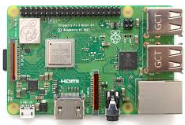
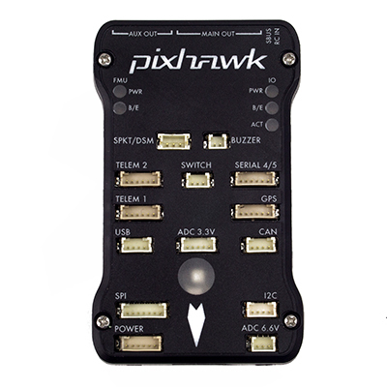
Smart-DRONE
Open-Hardware
Knowledge Level Modelling
Simulator
BDI Agent Architecture
Jadex for Android
MAVLink
MAVLink
ArduPilot – Flight Control
Notes:
The Intel® Edison module is a SoC (System on Chip) that includes an Intel® Atom™ 500MHz dual-core, dual-threaded CPU and an Intel® Quark™ 100MHz microcontroller.

Slide 25
FPV DRONE RACING
MARCHE DRONE WEEK
sabato 1 e domenica 2 dicembre
DRONE RACING FANO E IL CUS DI ANCONA ORGANIZZERANNO UN RADUNO SOCIALE DI PROMOZIONE SPORTIVA PER REALIZZARE SPETTACOLARI ESIBIZIONI NEL
CIRCUITO A LED INDOOR
https://ttp-technology.it/altro/raduni/marche-drone-week.html
Vi aspettiamo!!
Strada della Grotta, 19 A, 60126 Ancona AN

Slide 26
THANKS!

Slide 27
Some References
[Busetta et al., 2000] Paolo Busetta; Nicholas Howden; Ralph Ronnquist; Andrew Hodgson (2000). "Structuring BDI Agents in Functional Clusters". Intelligent Agents VI. Agent Theories Architectures, and Languages. Lecture Notes in Computer Science (Springer) 1757: 277–289. doi:10.1007/10719619_21. ISBN 978-3-540-67200-5.
[Dastani et al., 2005] M. Dastani, M. B. van Riemsdijk, and J.-J. Ch. Meyer. Programming multi-agent systems in 3APL, In R. H. Bordini, M. Dastani, J. Dix, and A. El Fallah Seghrouchni, editors, Multi-Agent Programming: Languages, Platforms and Applications. Springer, Berlin, 2005.
[Laddaga, 2006] Laddaga, R. (2006). Self adaptive software problems and projects. In Proceedings of the 2nd International IEEE Workshop on Software Evolvability (SE’06), pages 3–10, Washington, DC, USA. IEEE Computer Society.
[Morandini, 2006] Morandini, M. (2006). Knowledge level engineering of BDI agents. Master’s thesis, DIT, Università di Trento, Italy.
[Morandini et al., 2008] Morandini, M., Penserini, L., and Perini, A. (2008b). Automated mapping from goal models to self-adaptive systems. In Demo session at the 23rd IEEE/ACM International Conference on Automated Software Engineering (ASE 2008), pages 485–486.
[Morandini et al., 2009] Morandini M., Penserini L., and Perini A. (2009b). Operational Semantics of Goal Models in Adaptive Agents. In 8th Int. Conf. on Autonomous Agents and Multi-Agent Systems (AAMAS’09). IFAAMAS.

Slide 28
Some References
[Jadex, 2017] Jadex for Android Systems:
https://download.actoron.com/docs/releases/jadex-3.0.69/jadex-mkdocs/android/android/
[NPA, 2015-10] EASA Introduction of a regulatory framework for the operation of drones:
https://easa.europa.eu/document-library/notices-of-proposed-amendment
[NPA, 2015-17] EASA Airworthiness review process:
https://easa.europa.eu/document-library/notices-of-proposed-amendment

